Slide 1
How to use COUNT DISTINCT BY to create an Alma Analytics report of all portfolios which exist in multiple collections
Yoel Kortick | Sept. 2024

Slide 2
Introduction
How is it done?
Check results

Slide 3
Introduction

Slide 4
Introduction
In the situation here the institution wants to retrieve all electronic portfolios which exist in more than one electronic collection.
The methodology here can also be used for other fields in other subject areas.

Slide 5
How is it done?

Slide 6
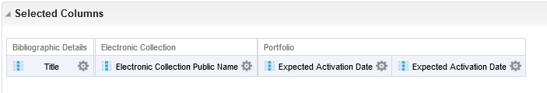
How is it done?
This institution has created an analysis in the E-Inventory subject area with the following fields in the criteria tab:
  "Bibliographic Details"."Title"
  "Electronic Collection"."Electronic Collection Public Name"
  Twice: Any other field (does not matter what because we will change it)
  Below our “Any other field” is "Portfolio"."Expected Activation Date"

Slide 7
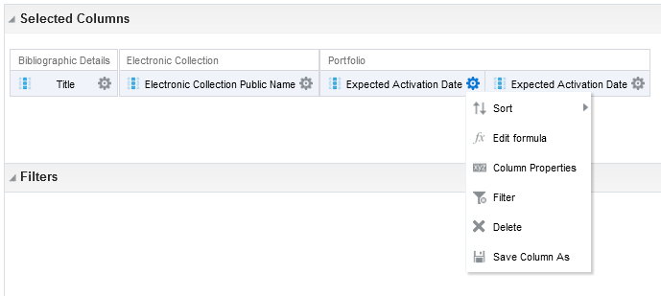
How is it done?
In the column with “any other field” (which in our example is "Portfolio"."Expected Activation Date") do “edit formula” and put the following formula.
This formula will tell us how many times the Portfolio ID of the title exists per MMSID
COUNT(DISTINCT "Portfolio"."Portfolio id" BY "Bibliographic Details"."MMS Id")
Change the column heading to be “Num. of portfolios per title”

Slide 8
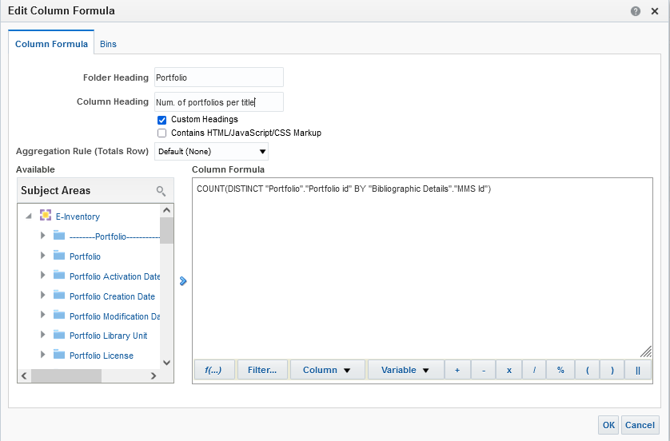
How is it done?
Here is the field with the new formula and new column heading

Slide 9
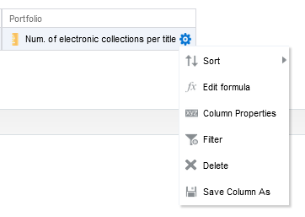
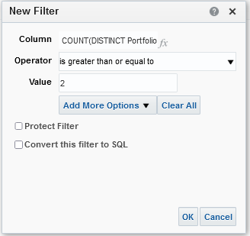
How is it done?
Now we can filter by this field to get only values which are 2 or greater

Slide 10
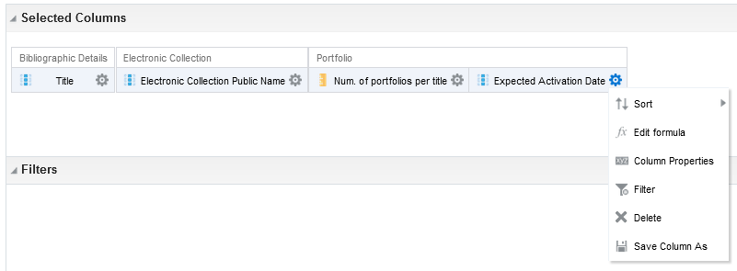
How is it done?
In the other column with “any other field” (which in our example is "Portfolio"."Expected Activation Date") do “edit formula” and put the following formula.
This formula will tell us how many times the Electronic Collection ID exists per MMSID
COUNT(distinct "Electronic Collection"."Electronic Collection Id" BY "Bibliographic Details"."MMS Id")
Change the column heading to be “Num. Electronic Collections”

Slide 11
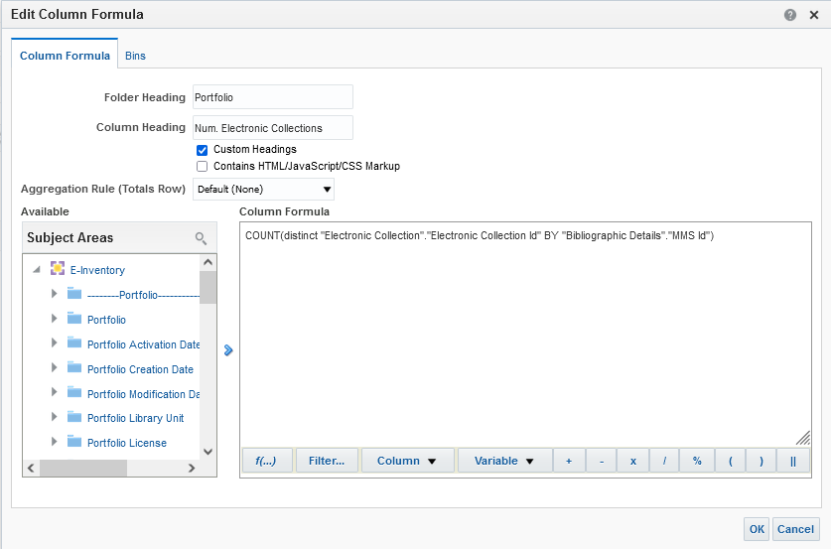
How is it done?
Here is the field with the new formula and new column heading

Slide 12
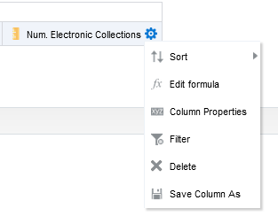
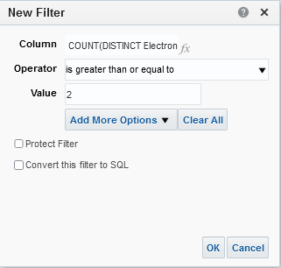
How is it done?
Now we can filter by this field to get only values which are 2 or greater

Slide 13
How is it done?
In order to avoid getting deleted entities we will add the followi9ng filters. There is no need to display these fields, only filter by them.
"Portfolio"."Lifecycle“ = “In Repository”
"Electronic Collection"."Electronic Collection Lifecycle“= “In Repository”
"Bibliographic Details"."Bibliographic Lifecycle" = “In Repository”

Slide 14
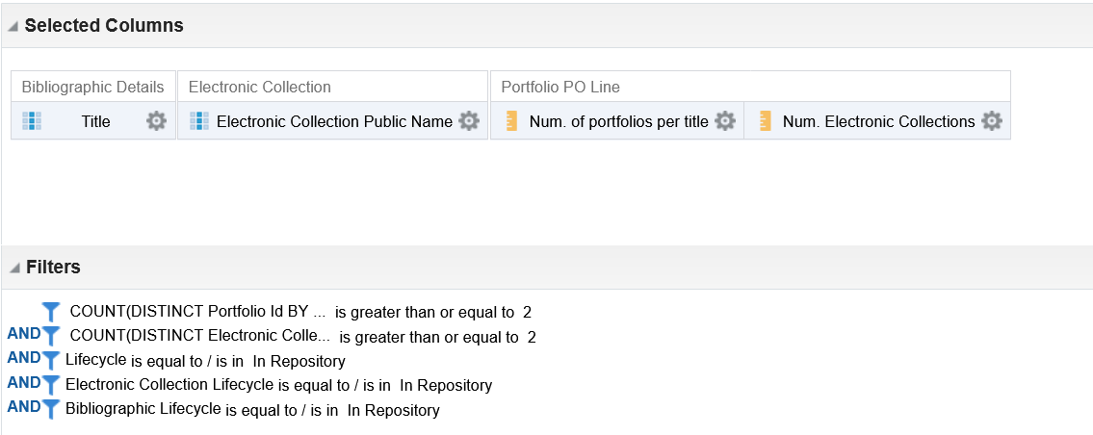
How is it done?
Now we have these columns and these filters

Slide 15
Check results

Slide 16
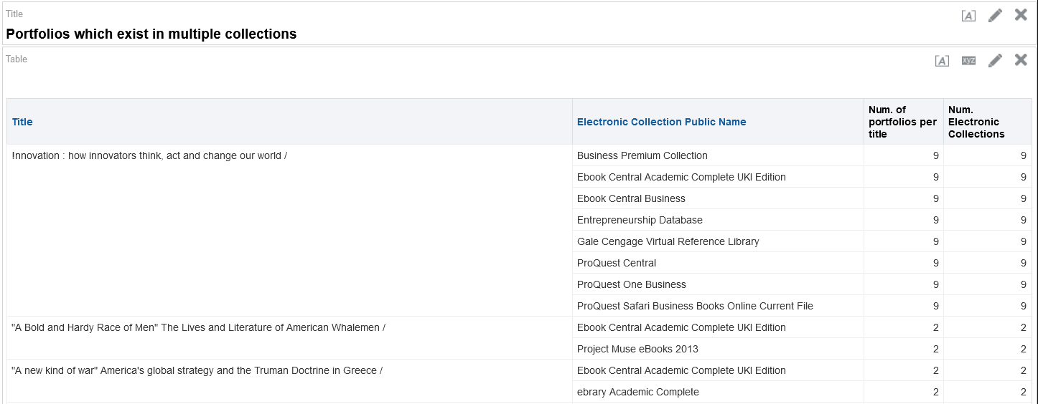
Check results
Here is the report now
Let’s now check the first result “!nnovation : how innovators think, act and change our world /” which according to the report exists in 9 portfolios in 9 different electronic collections

Slide 17
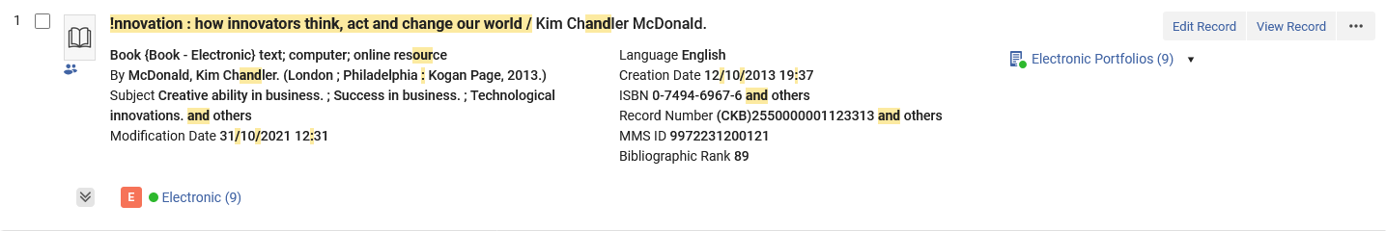
Check results
An “all titles” search for the title shows that (as the Analytics report states) there are 9 portfolios.

Slide 18
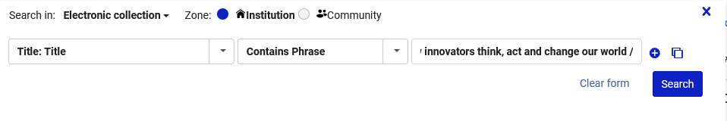
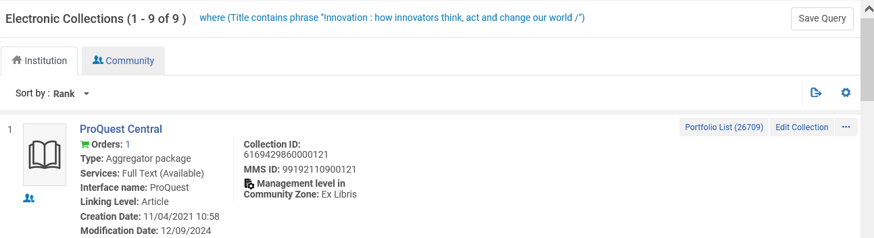
Check results
A “Electronic Collection” search for the title shows that (as the Analytics report states) there are 9 Electronic Collections.

Slide 19
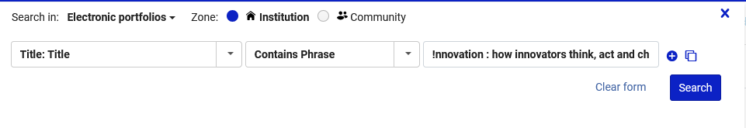
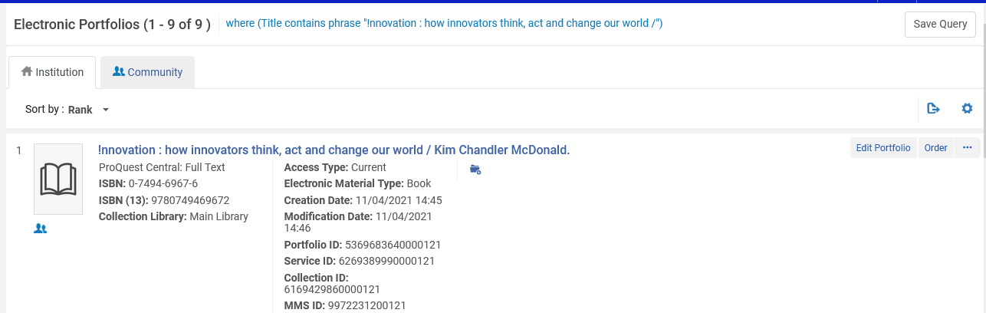
Check results
An “Electronic Portfolios” search for the title shows that (as the Analytics report states) there are 9 Electronic Portfolios.

Slide 20
Thank You.
Yoel Kortick

